Slide 1
Essentiality of DPL1 and DPL1&PSD2: Statistical Learning
Ensemble Trees
Features:
# Reads
# Transposons
Transposon without ends of genes
Transposon density
Transposon free region
±Neighborhood index
Total length of gene
Not used yet:
Hits in promoter
Noncoding sequence (including introns) within 10 kb up- and downstream of ORF
5185
225
True class
91.8% correct
Essential Non-ess
315
878
Non-ess Essential
Predicted class
Next up:
Add features
Improve features
Check with WT2 dataset
Compare dpl1Δpsd2Δ and dpl1Δ

Slide 2
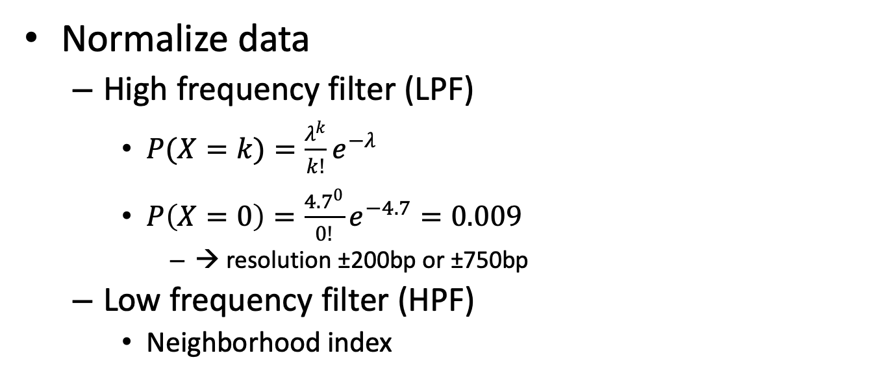
SATAY Data Analyses
Normalize data
High frequency filter (LPF)
$P(X=k)=\frac{λ^{k}}{k!}e^{−λ}$
$P\left(X=0\right)=\frac{{4.7}^{0}}{0!}e^{−4.7}=0.009$
→ resolution ±200bp or ±750bp
Low frequency filter (HPF)
Neighborhood index
# transposons
Position in chromosome

Slide 3
SATAY Data Analyses
bp Position of transposon insert
Position #Transposons
684
1214
2300
2313
2956
…
1 | 0
2 | 0
3 | 1/750
4 | 1/750
5 | 2/750
… | …

Slide 4
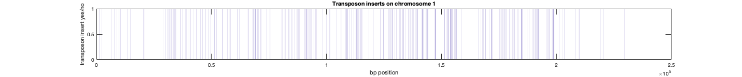
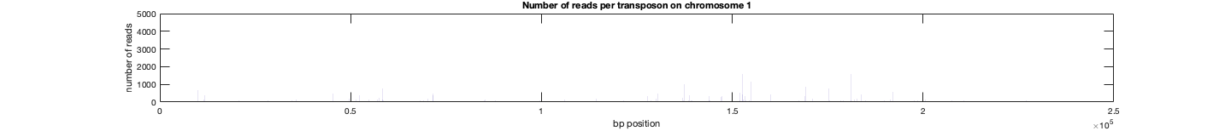
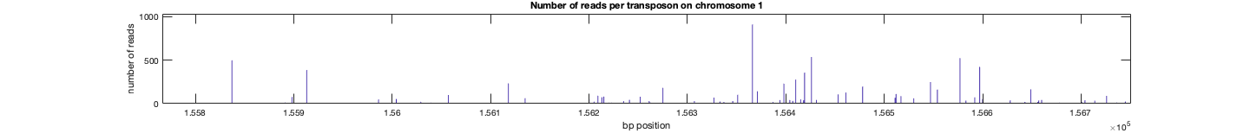
SATAY Data
Transposon inserts (tot:11153)
Read number (average 72 per transposon)

Slide 5
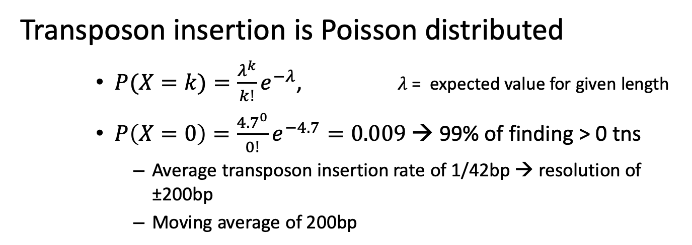
Interpretation
Transposon insertion is Poisson distributed
$P(X=k)=\frac{λ^{k}}{k!}e^{−λ}$, $λ$= expected value for given length
$P\left(X=0\right)=\frac{{4.7}^{0}}{0!}e^{−4.7}=0.009$ → 99% of finding > 0 tns
Average transposon insertion rate of 1/42bp → resolution of ±200bp
Moving average of 200bp

Slide 6
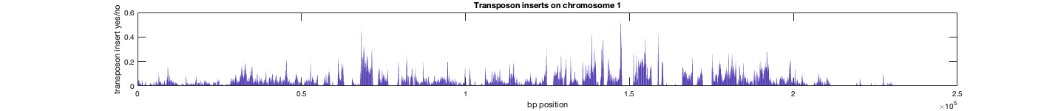
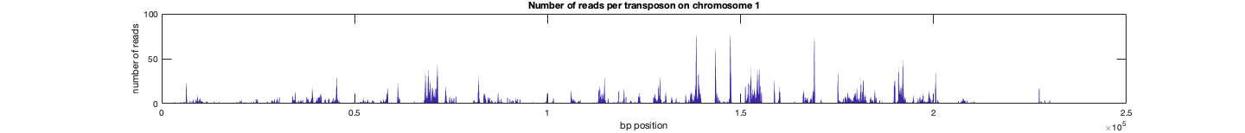
Moving average 200bp
Transposon inserts (tot:11153)
Read number (average 72 per transposon)

Slide 7
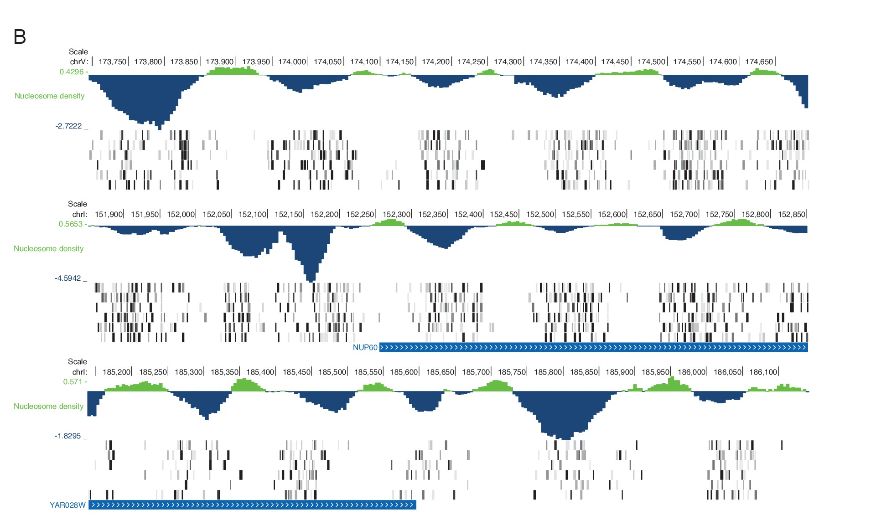
Moving average 200bp
160bp frequency due to nucleosomes?
Effect on Poisson distribution?
Michel et al. 2017

Slide 8
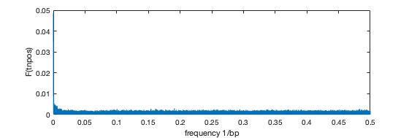
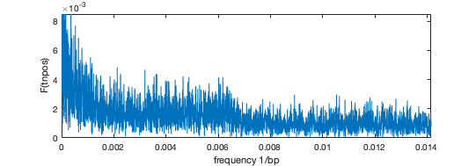
Moving average 200bp
Frequency spectrum of Transposon positions chr. 1
160bp frequency due to nucleosomes?
Effect on Poisson distribution?
zoom
1/160 = 0.0063

Slide 9
Moving average 200bp
700bp
Frequency spectrum of Transposon positions chr. 1
160bp frequency due to nucleosomes?
Effect on Poisson distribution?
zoom
1/160 = 0.0063

Slide 10
High Frequency Filter
200bp – from 42bp average
700bp – from 160bp nucleosome
Depending on transposon density per chromosome?
Or…. More local?

Slide 11
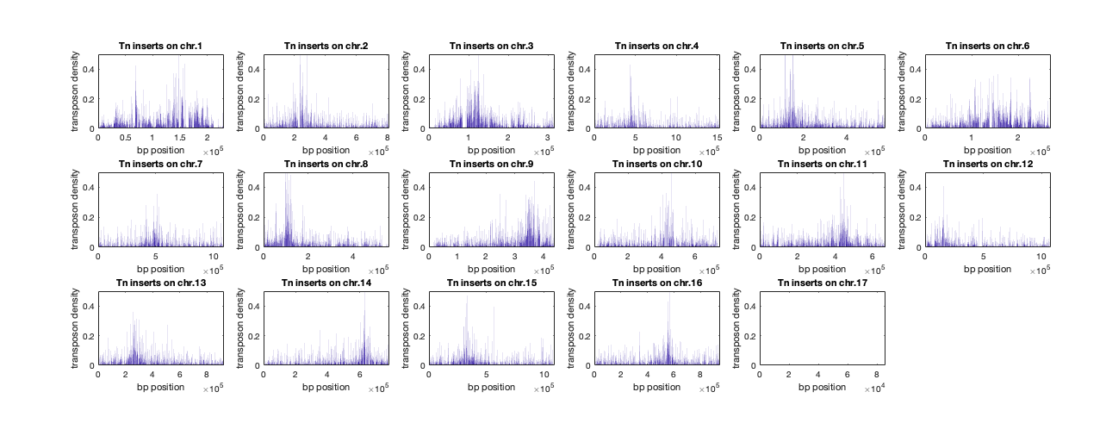
High Frequency Filter
Centromere bias

Slide 12
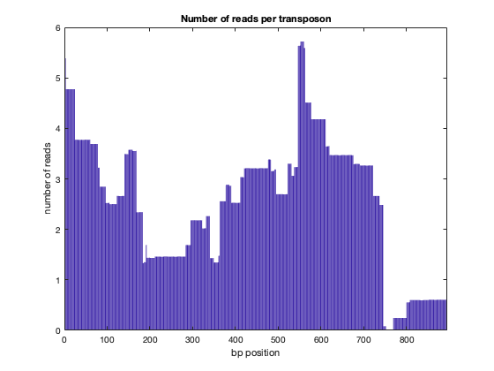
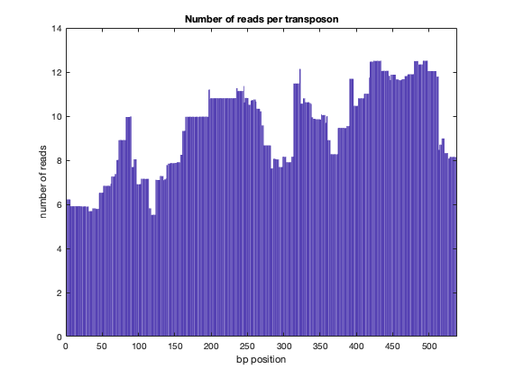
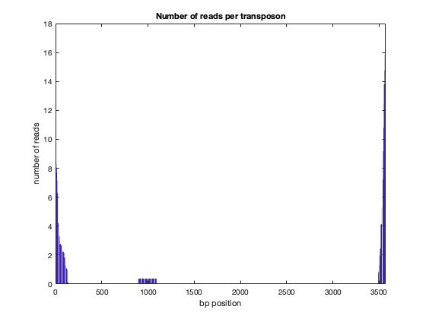
Fitness effect
“Non-essential gene”
“Essential gene”

Slide 13
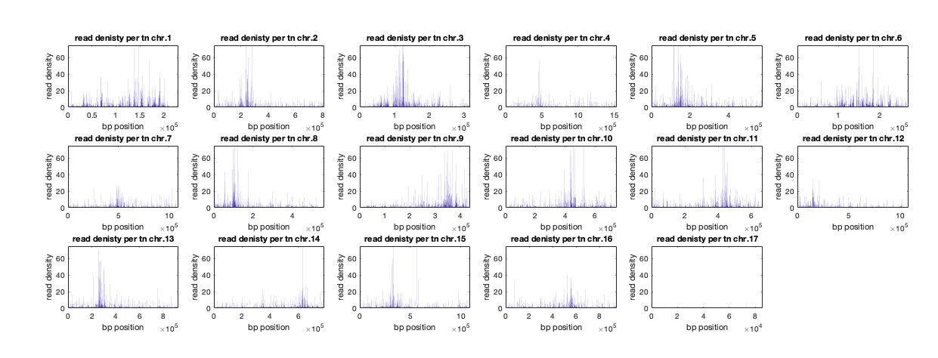
Fitness effect
Centromere bias

Slide 14
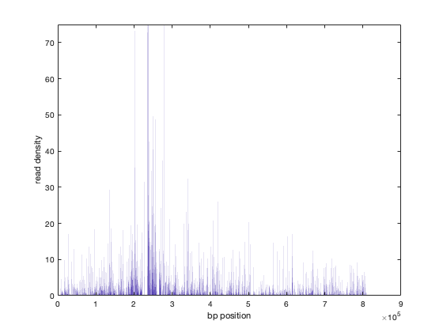
Fitness effect
Reads in chromosome 2

Slide 15
Fitness effect
Static or Dynamic?
gene
10kb neutral regions
10kb neutral regions

Slide 16
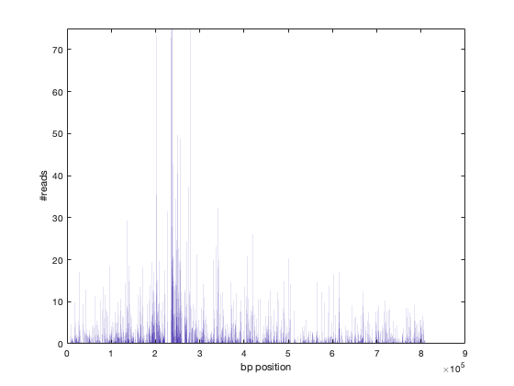
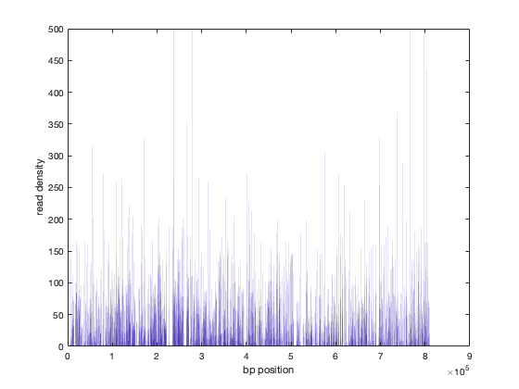
Fitness effect
/#tn

Slide 17
Fitness effect
/#tn
Static or Dynamic?
10kb neutral regions
gene
10kb neutral regions

Slide 18
Questions
How to filter high-frequency? (Transposons)
How to filter low-frequency? (Reads)
How to normalize for exponential growth of reads?

